Slide 1


Slide 2
FACE RECOGNITION USING MATLAB
Digital Signal Processing (EE-330) Fall 2021 Instructor: Dr Arbab Latif Lab Instructor: Abrar ul Haq

Slide 3
GROUP MEMBERS
No | Name | CMS ID
1 | Muneeb Elahi Malik | 288106
2 | Ch Muhammad Shaheer Yasir | 286021
3 | Muhammad Hamza | 290951

Slide 4
INTRODUCTION
Use of object detection in different technologies is ubiquitous in today’s world. From our smartphones to security surveillance systems, it is an important aspect of computer vision and image processing applications. As it becomes more and more popular the demand of having an accurate object detection algorithm is increasing day by day.

Slide 5
Face Recognition with MATLAB
Face recognition is the process of identifying one or more people in images or videos by analyzing and comparing patterns. Algorithms for face recognition typically extract facial features and compare them to a database to find the best match. Face recognition is an important part of many biometric, security, and surveillance systems, as well as image and video indexing systems.

Slide 6
Face Recognition Advantages
Face recognition uses focus on verification or authentication:
Second authentication factor, to add extra security in any log-in process.
Access to mobile applications without a password.
Access to previously contracted online services (login on online platforms, for example).
Access to buildings (offices, events, facilities of any kind).
Payment method, both in physical and online stores.
Access to a locked device.
Check-in in tourist services (airports, hotels…)..

Slide 7
OBJECTIVES
Our aim is to develop an accurate object detection program in MATLAB which is efficiently able to distinguish various features in faces. We will try to employ different algorithms of real time image processing and select the one which shows best results. The great difficulty is ensuring that this process is carried out in real-time, something that is not available to all biometric facial recognition software providers.

Slide 8
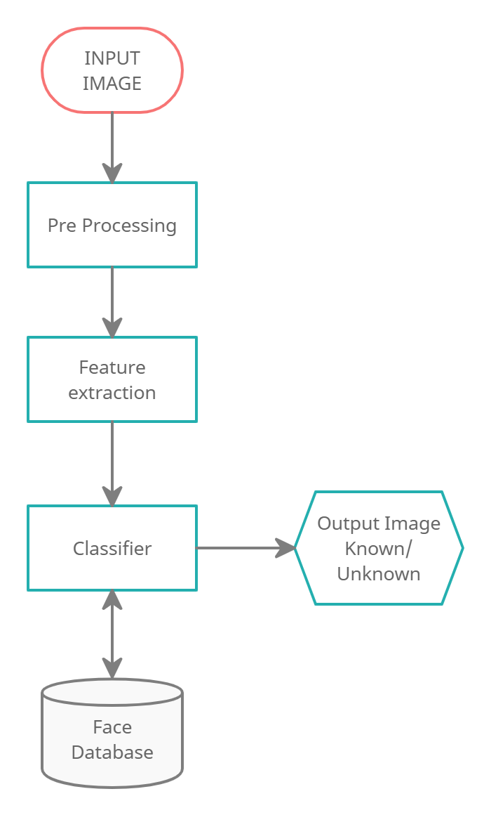
PROPOSED DESIGN

Slide 9

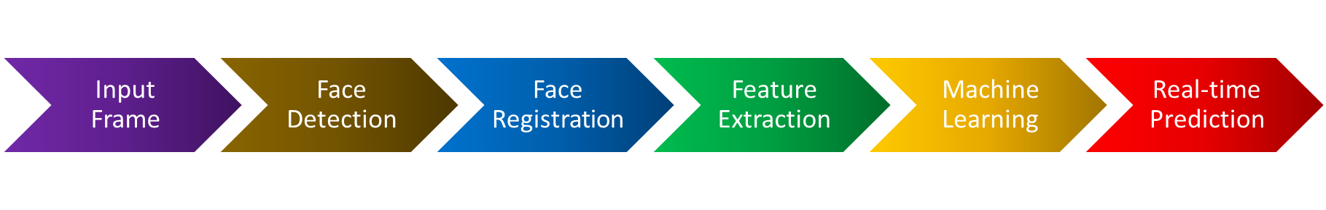
WORKING

Slide 10
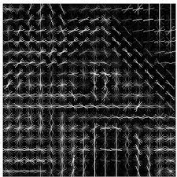
HOG (Histogram of Oriented Gradients):
Histogram of Oriented Gradients, also known as HOG, is a feature descriptor. It is used in computer vision and image processing for the purpose of object detection. The technique counts occurrences of gradient orientation in the localized portion of an image. The HOG descriptor focuses on the structure or the shape of an object. It is better than any edge descriptor as it uses magnitude as well as angle of the gradient to compute the features. For the regions of the image it generates histograms using the magnitude and orientations of the gradient . This means that the complete image is broken down into smaller regions and for each region, the gradients and orientation are calculated.

Slide 11
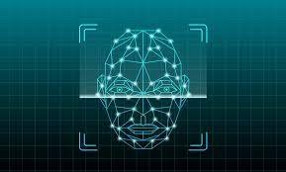
FEATURES:
Registration of New Face in Webcam through Image Acquisition Toolbox
Image Processing Toolbox
Label of New Face captured by Webcam
Extract Features for Machine Learning
Machine Learning and Prediction
Performs Real-Time Facial Recognition

Slide 12
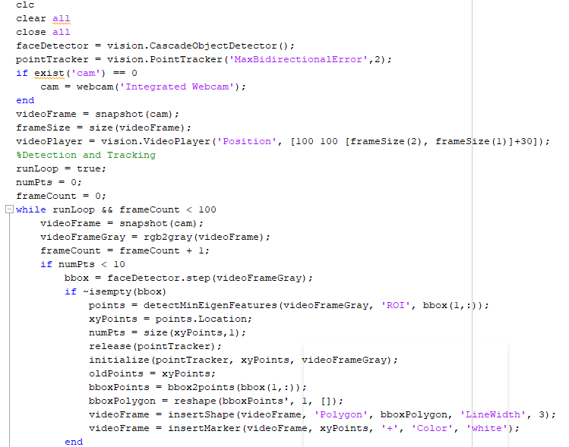
Setting Up Data:

Slide 13
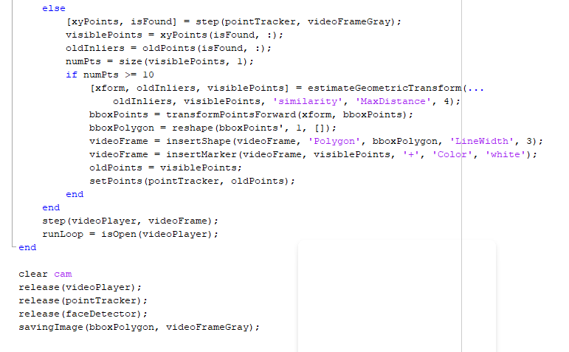
Setting Up Data:

Slide 14
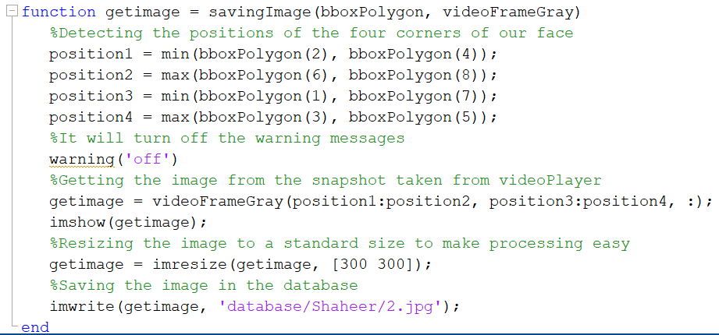
SAVING IMAGE

Slide 15
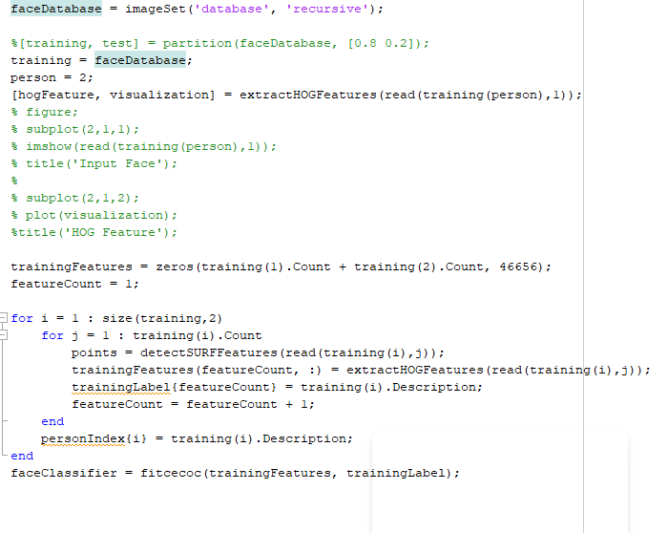
TRAINING DATA:

Slide 16
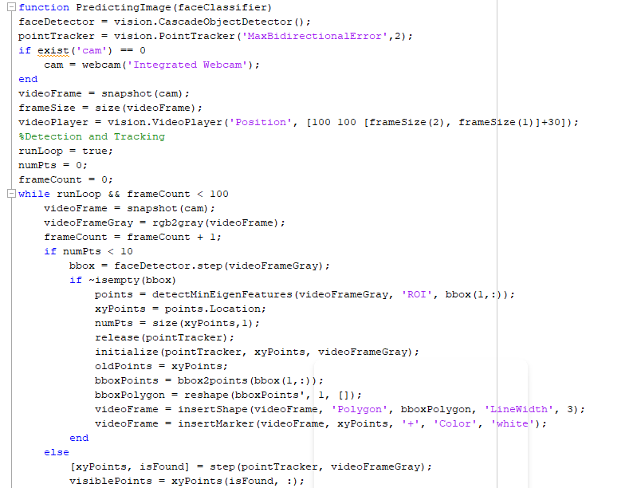
Predicting Image:

Slide 17
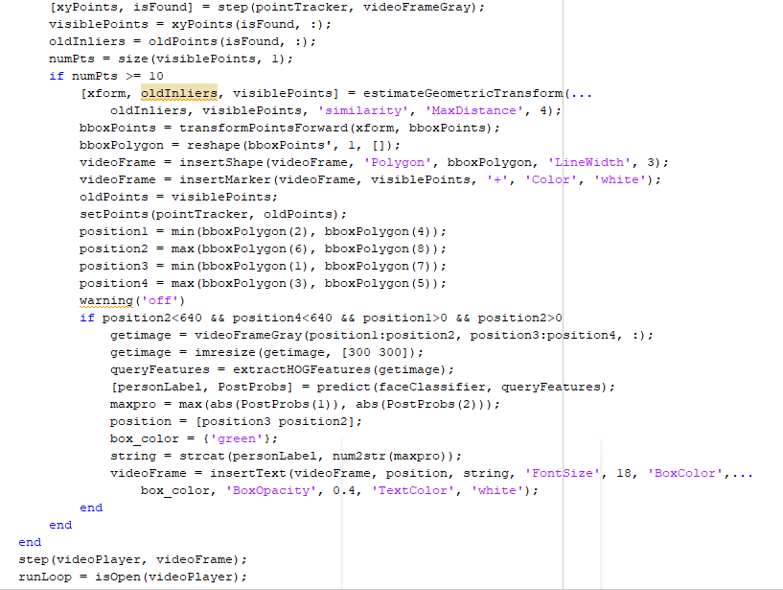
Predicting Image:

Slide 18
Conclusion:
In order to increase the accuracy, we may insert larger dataset, extract more facial features for machine learning, consider other machine learning model, or even try deep learning.
The intelligent interaction between the human and the computer is of vital importance to reach the primary and contemporary goals of artificial intelligence.
Digital imaging in life and in common society and in science and technology has become completely digital and this transformation of visual imagination into mathematical algorithms and numerical developments is significant for researchers to use it in everyday digitized world we live today.

Slide 19
REFERENCES:
Singh, Swarnima & Singh, Durgesh & Yadav, Vikash. (2020). Face Recognition Using HOG Feature Extraction and SVM Classifier. 8. 6437-6440. 10.30534/ijeter/2020/244892020.
Kevin Chng (2022). Real-Time Facial Recognition Using HOG Features (https://github.com/KevinChngJY/real_time_facial_recognition/releases/tag/1.1), GitHub.
GK BHAT (2022). Real time face recognition and detection system (https://www.mathworks.com/matlabcentral/fileexchange/46674-real-time-face-recognition-and-detection-system), MATLAB Central File Exchange.

Slide 20
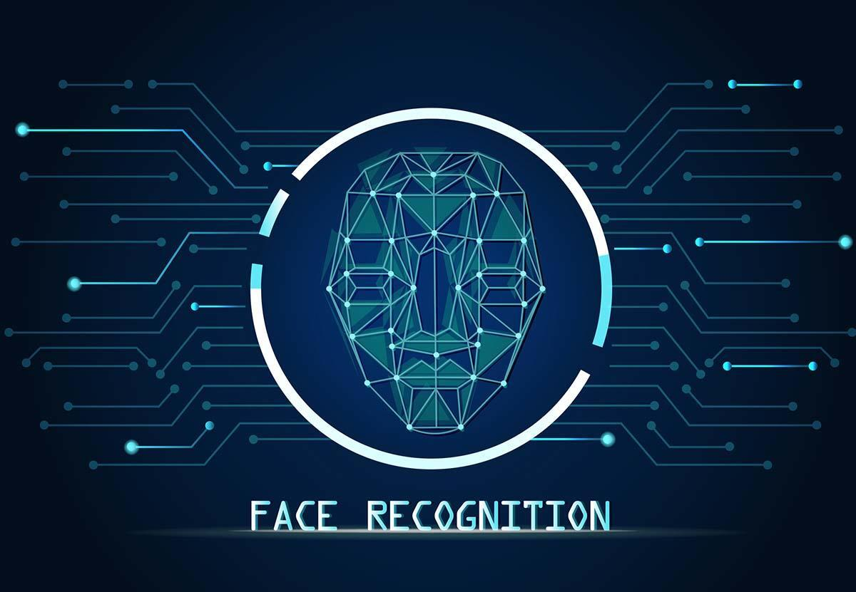
THANK YOU!

Slide 21
Any questions?

